Slide 1
Namma Yatri Visualisation Analysis
By Sana Aafreen

Slide 2
Purpose
Namma Yatri seeks to optimise its operations and gain deeper insights into ride patterns, customer behaviour, and operational bottlenecks.
The goal is to uncover insights that can guide decisions to improve service efficiency, maximise revenue, and enhance customer satisfaction.

Slide 3

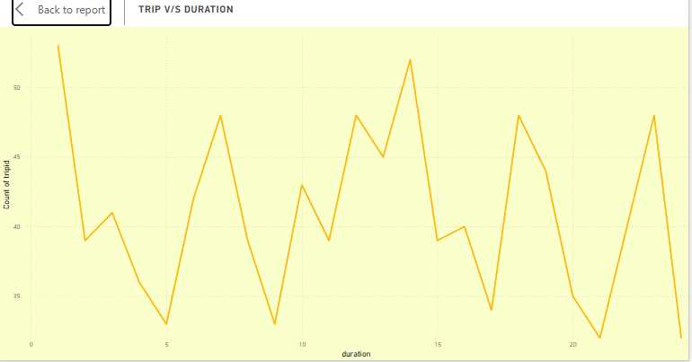
Technical Analysis
Identifying peak demand patterns and dmeand trends.
Uncover factors influencing cancellations and driver performance.
Optimize payment methods and trip durations.
Improve resource allocation and marketing strategies

Slide 4

Trips v/s Searches
Analysed Total completed trips with reference to Total searches giving a conversion rate of 45%.
Estimates verses Actual Fare= Total completed trips/ Sum of Total Estimates shows that only 55.9% of the estimated trips is actually travelled.

Slide 5
Insights
Demand isn't just concentrated in morning/evening commutes; there's significant activity around lunchtime and also very late at night/just after midnight.
The lowest demand occurs consistently in the pre-dawn hours (around 4-5 AM).
0-1 (Midnight - 1 AM) - Highest Peak
13-14 (1 PM - 2 PM) - Very High Peak
7-8 (7 AM - 8 AM) - Morning Peak
18-19 (6 PM - 7 PM) - Evening Peak
23-24 (11 PM - Midnight) - Late Night Peak

Slide 6
Metrics
Trip Efficiency:
The data includes metrics on the efficiency of the ride-sharing service, such as the number of searches that resulted in estimates and quotes, and the number of trips completed without cancellations.
Geographical Coverage:
The assembly data indicates a wide geographical coverage within Bangalore, suggesting a comprehensive service area.
Payment Preferences:
The payment methods section highlights the variety of payment options available to customers, which can be useful for understanding customer preferences and improving service offerings.

